Slide 1


AV-Tube (An online Video Library)
REVIEW - 3
School of Computer Science & Application
Internet Web Programming
Team Members:
Akash kumar(21MCA1021)
Naveen Gupta(21MCA1042)
Lakshya (21MCA1056)
Nikhil Saraogi (21MCA1080)
Under the Guidance of
Dr. Sandeep kumar Satapathy

Slide 2
Project scope:
This is a video streaming site name– “AV-Tube”
Av-Tube like a YouTube is a website designed for sharing video. Millions of users around the world can have create accounts on the site that allow them to upload videos that anyone can watch. Through Av-Tube people can watch videos, share-videos, Upload-videos and can even download them.

Slide 3
Functional requirement(SRS) :
1. SignIn/SignUP-
1.1.Description: Allows user to signup/signin
1.2.Input: E-mail Id, Password
1.3.Output: Allows user to register their account on signup and allows user to access on signing in.
1.4.Processing: When user signup, system create new database and register that user and when user sign in it matches the login-credentials from the database and if matches grant the access.

Slide 4
2. Search
2.1.Description: Allows user to search any video through entering keyword.
2.2.Input: Input Keyword
2.3.Output: Display videos related to keywords.
2.4.Processing: Matches the keyboard in the database and display videos according to that.
3. Download-Videos
3.1.Description: Allows user to download videos
3.2.Input: Click on the download button
3.3.Output: Pop-up appeared that video has been downloaded.
3.4. Processing: Fetch the video from server that has been store database and transfer the video file to user device through download.

Slide 5
4.Upload-Videos
4.1.Description: Allows user to upload their videos into his account/channel.
4.2.Input: Click on Upload Button.
4.3.Output: New window pop up asking to select the file to upload.

Slide 6
Non functional requirement :
1.Safety-Requirements-
If there is extensive damage to a wide portion of the database due to catastrophic failure, such as a server-crash, there cover method restores a past copy of the database that was backed up to archival storage(typically tape)and re-constructs a more current state by reapplying or redoing the operations of committed transactions from the backed up log, up to the time of failure. And in the mean while, the server switch to the backup servers to keep the site working.

Slide 7
2. Security Requirements-
Security systems need database storage just like many other applications. However, the special requirements of the security market mean that owner must choose their database partner carefully. All the Private data uploaded by the user is absolutely confidential to the other users. User can also report for if the find any suspicious activity in the AV-Tube, so the security department can take care of that.

Slide 8
3. Software Quality Attributes -
AVAILABILITY: The site is available for the users 24x7.
MAINTAINABILITY: The developers and a team of software engineers work on the maintenance and the updates of the site.
USABILITY: The site can be used anywhere if the connectivity to the internet and a device.
4. DESIGN-Phase -
Design phase deals with transforming there requirements, as described in the SRS document into a form that can be used while programming. In design phase of SDLC based on requirement captured in SRS.

Slide 9
dFd (data flow diagrams)
Level 0 :-
Login
Data
AV-TUBE
SERVER
USER
Send Data
Access Granted

Slide 10
Level 1:
Search Videos
Upload
Account setting
Home page
Username
Login
password

Slide 11
Level 2:
Search video
Check server for video
Display video List
Keyword

Slide 12
Level 3:
Select file
Click upload
Message popup “uploaded”
Upload
Click on upload button
File stored in the server
Upload Success
Server

Slide 13
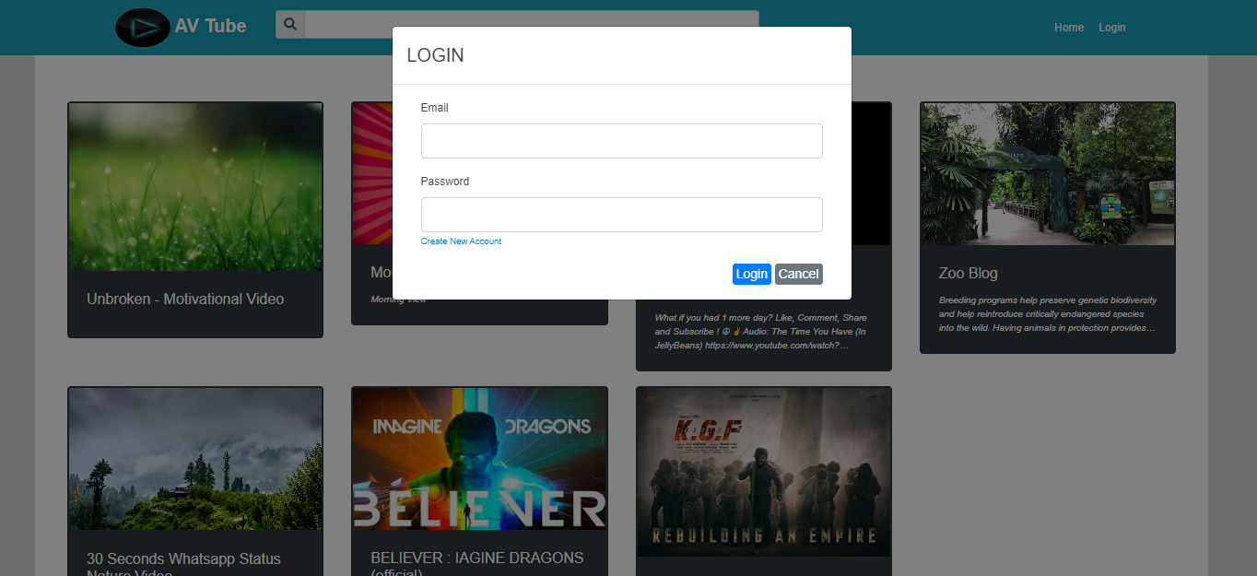
LOGIN PAGE FOR EXISTING USER

Slide 14
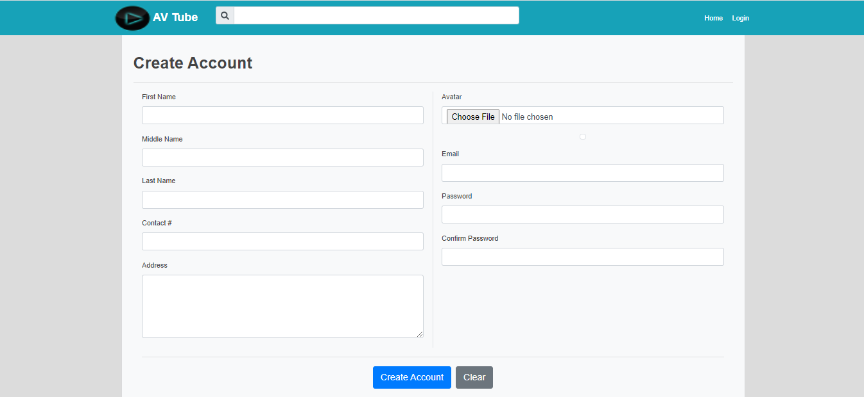
REGISTER PAGE FOR NEW USER

Slide 15
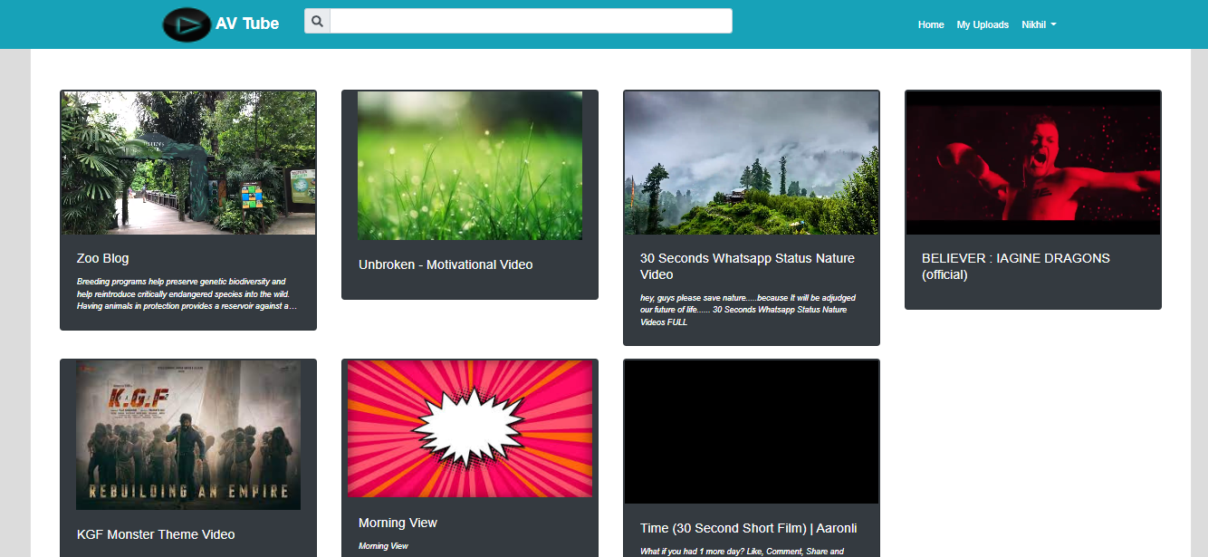
HOMEPAGE AFTER LOGIN

Slide 16
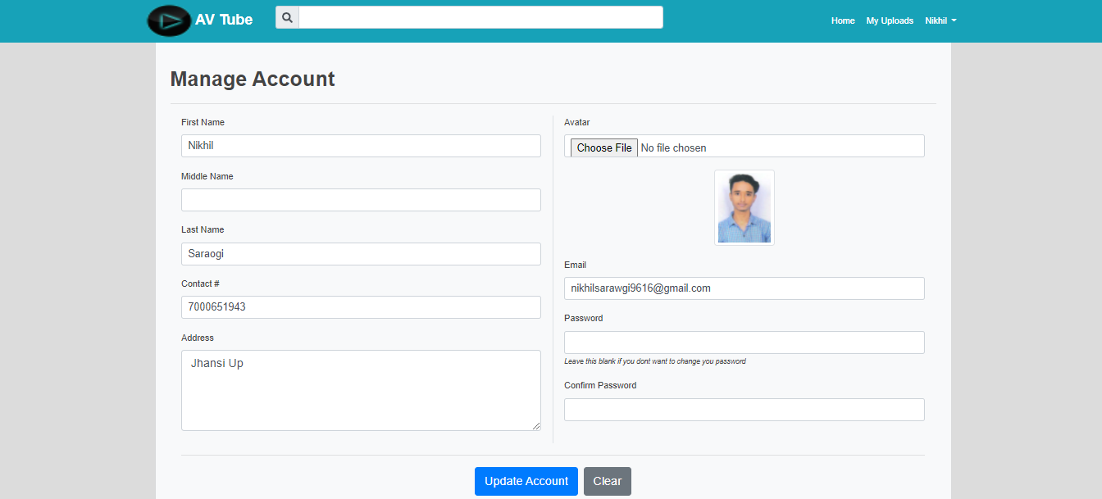
USER ACCOUNT INFO

Slide 17
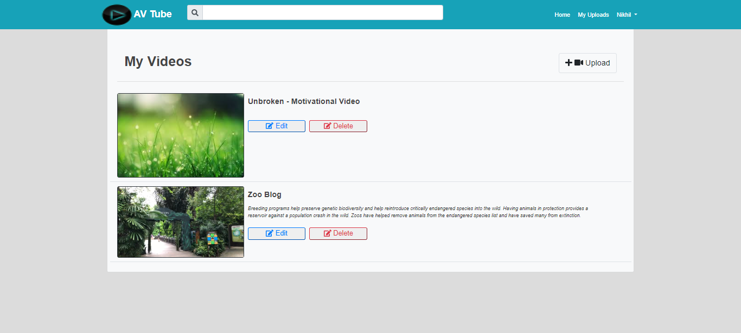
UPLOADED VIDEO BY USER

Slide 18
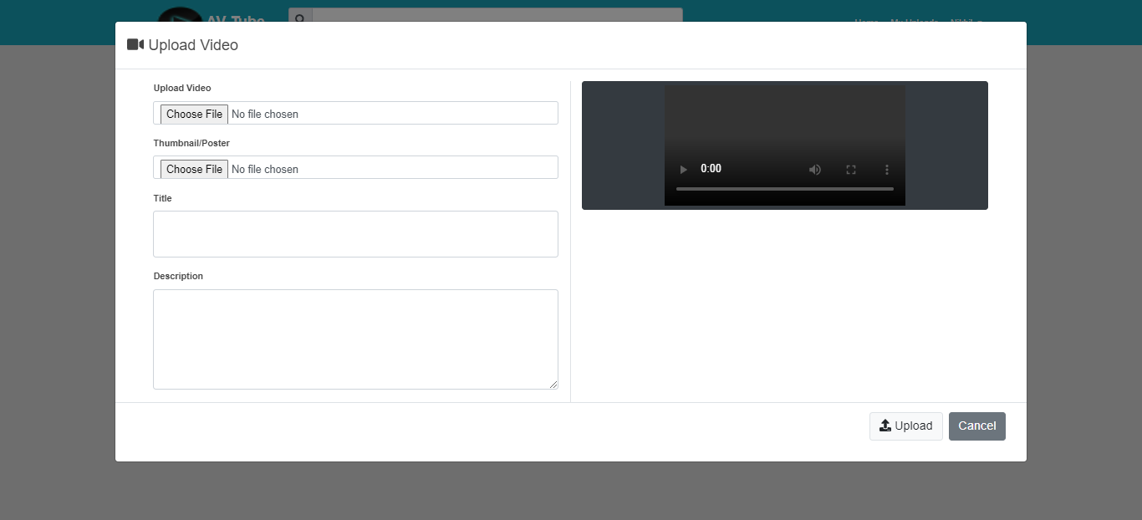
UPLOAD VIDEO

Slide 19
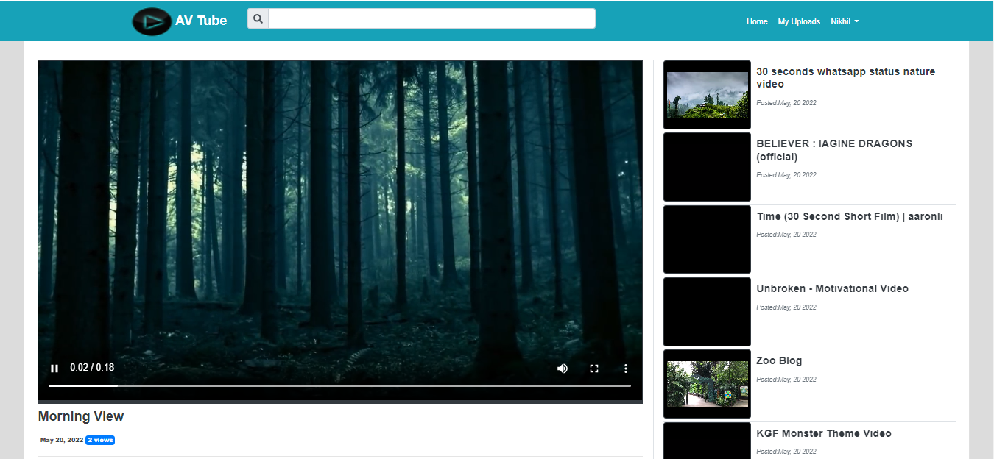
HOME SCREEN PLAYING VIDEO

Slide 20


